Slide 1

CEIR Type Approval Feature -Training Manual

Slide 2

Agenda
Feature Overview
Stakeholder Overview
State Diagram
UI Walk Thru
View All Type Approval Request
View A Type Approval Request
Request Type Approval
Withdraw Type Approval Request
Edit Type Approval Request
Approve Type Approval Request
Reject Type Approval Request

Slide 3


Feature Overview
Type Approval Feature allows importer to register SIM based devices with TRC so that these devices can be then be sold in the Cambodian market. The details for device that need to be approved can be uploaded using this feature
TRC can also update Type Approved TAC in the system
Typical flow is as follows:
Importer register with TRC
Importer seek permission to import SIM based devices from TRC
TRC approve the import of certain SIM based devices
Importer upload the document along with the permission certificate on the CEIR portal
CEIR Admin approves the request
Importer consignment process flow from here on.
Register with TRC
Seek Permission to Import
Importer
TRC Personnel
Upload TRC
Document
Upload TRC
Document
CEIR System
Approve/Reject
Request
CEIR Admin

Slide 4
Feature Impact
Importance of this feature for the CEIR System
Type Approved TAC list cannot be prepared
Impact is Low as the system is integrated with GSMA which provide approved TAC list that are valid to be used
This Type Approved TAC list indicate which devices are approved to be sold in Cambodian market
Production of SIM based Devices by manufacturer would need a TAC that is provided by GSMA.
VS
Selling of SIM based Devices by importer in Cambodia would need a TAC that is approved by TRC.

Slide 5
Stakeholder Overview

Slide 6
State Transition – Overview – Type Approval
User
System
CEIR Admin
INIT
PROCESSING
Pending for CEIR Approval
Approved
Upload
System
Process
System
Process
Approve
TAC Request State under various Stakeholder
System
Process
Edit
Reject
Rejected by System
Edit by Importer
Edit
Rejected by
CEIR Admin

Slide 7
State Transition - Overview
TAC State | Meaning
New | Importer has registered a new TAC for Type Approval
Processing | The system has started the processing of this request
Rejected by system | The system has found an error, most likely, policy-based errors
Pending approval from CEIR Admin | The request processing is successful, request is accepted and now it is sent to CEIR Admin for approval
Rejected by CEIR Admin | CEIR Admin has rejected the request
Approved | CEIR Admin has approved the request
Withdrawn by User | User has withdrawn the request.
Withdrawn by CEIR | CEIR Admin has withdrawn the request.

Slide 8
UI – Overview - Feature
S.No. | Feature | Stakeholder
1 | View all Type Approval Request (Only those that are pending for action on user) | Importer, CEIR Admin, TRC
2 | Register Type Approval Request | Importer, TRC
3 | Approve Request | CEIR Admin
4 | Reject Request | System, CEIR Admin
5 | Edit | Importer, TRC
6 | Delete (Withdraw) | Importer, CEIR Admin, TRC
7 | View | Importer, CEIR Admin, TRC

Slide 9
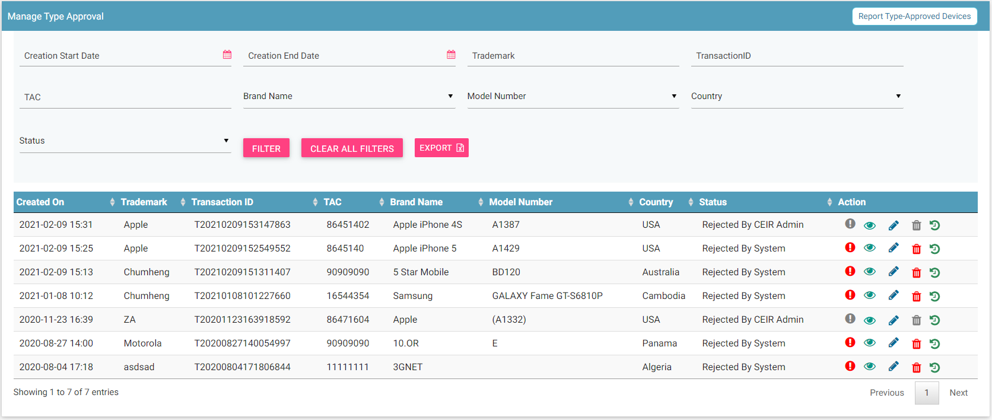
Type Approval Request
Report
Filters
Export
Action like View, Edit Delete, History
View All

Slide 10
Action List
Action are enabled / disabled based on the state of the request.

Slide 11



Actions Enabled/ Disabled for Importer / TRC

Slide 12
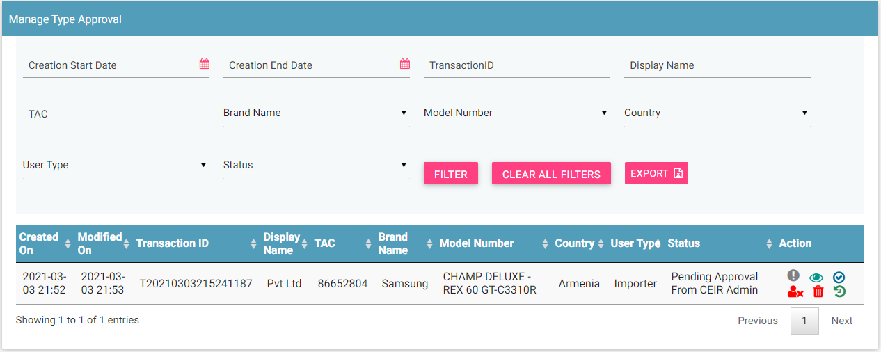
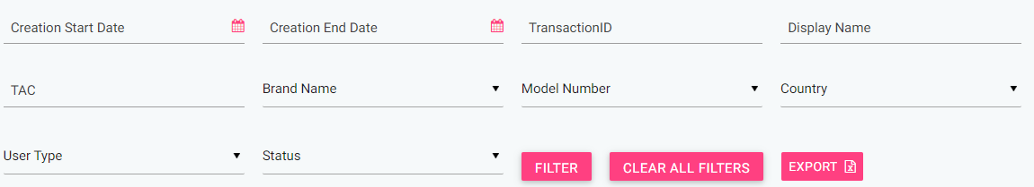
CEIR Admin Portal
By default, request with status “Approval pending from CEIR Admin” will be displayed in the CEIR Admin queue.
In case CEIR Admin wishes to view request in any other state, they can use the filter options to display the same.

Slide 13
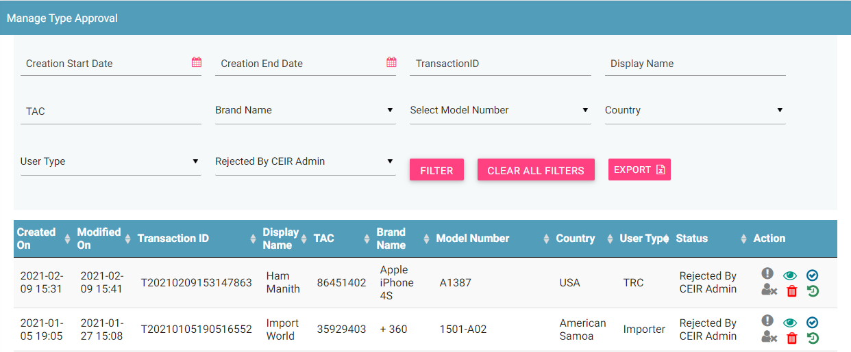
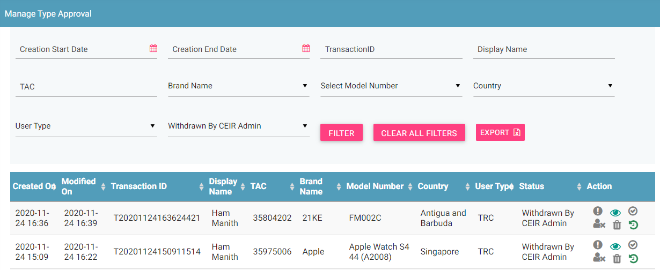
CEIR Admin Portal (contd.)
For status APPROVAL PENDING FROM CEIR ADMIN, actions like View, Approve, Reject and Withdraw will be enabled for CEIR Admin.
For status as REJECTED BY CEIR ADMIN , actions like View, Approve and Withdraw will be enabled for CEIR Admin.
For status as WITHDRAWN BY CEIR, only View option will be enabled for CEIR Admin.
All other states will have only View option enabled for CEIR Admin.

Slide 14
Type Approval Flow
Importer report a type approved devices.
In order to report a type approved devics , an Importer needs to furnish the following details:
→ Trademark, → Brand Name
→ Model Name → Manufacturer Country,
→ Frequency Range →TAC,
→ Document Type → Upload Supporting Document
A unique Transaction ID is generated for each new request which is reported. This transaction id can be used in future for raising grievance (if any) regarding the request. The transaction ID will be used for tracking the request at any state. Status = NEW
System processing is being done at the backend. Status = PROCESSING
In case the requestis rejected by system. Status = REJECTED BY SYSTEM
System rejects the request in case there is some issue with the any parameters or any policy violation is done.

Slide 15
Type Approval Request Flow ( contd..)
After successful internal processing, the request is sent to the CEIR Admin queue for Approval/ Rejection. Status = PENDING APPROVAL FROM CEIR ADMIN.
CEIR Admin rejects the request. Status = REJECTED BY CEIR. Email is sent to Importer/TRC. Notifications is also displayed on the Importer/TRC dashboard.
CEIR Admin can also withdraw request. Status = WITHDRAWN BY CEIR. This can be done in scenarios like request is rejected by CEIR admin and importer has not rectiified it.
CEIR Authority approves the request.. Status = APPROVED. Email is sent to Importer/TRC. Notifications are also displayed on the Importer / TRC dashboard.
Importer/TRC can also withdraw request when it is in either NEW/ REJECTED BY SYSTEM state. Status = WITHDRAWN BY USER

Slide 16
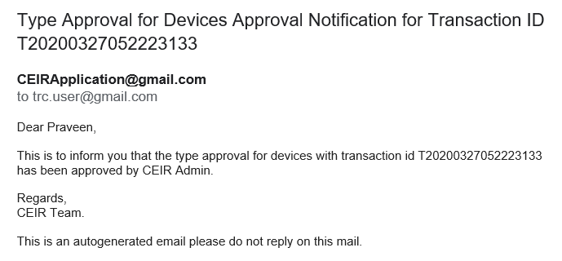
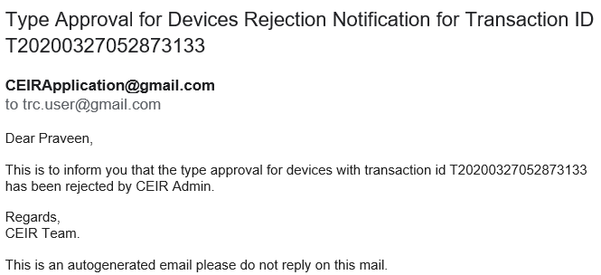
Email samples
Approved by CEIR
Rejected by CEIR
Email contents can be configured from the System Admin portal. This will be explained in detail in the system configuration training.

Slide 17
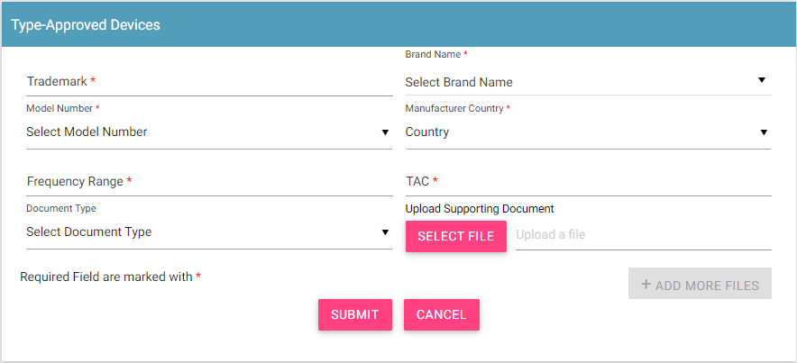
Register Type Approval Details

Slide 18
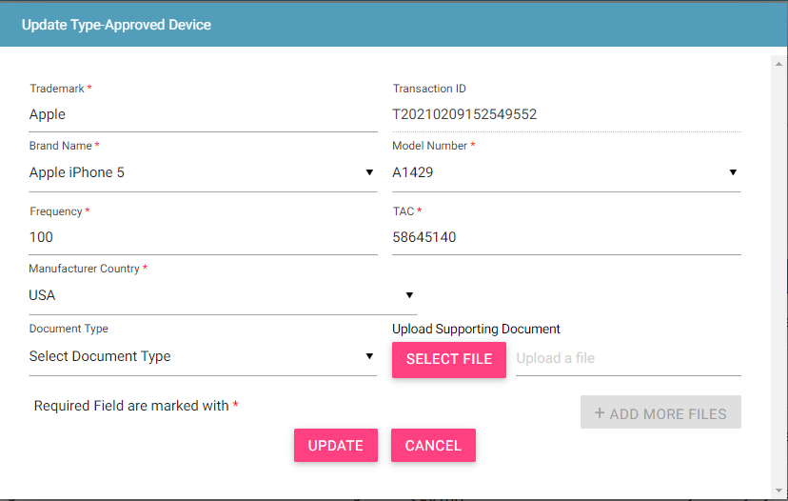
Update Type Approval Request
Only allowed in rejected states
Rejected By CEIR Admin
Rejected By System
Edit By Importer / TRC
NEW
Request moved back to NEW state

Slide 19
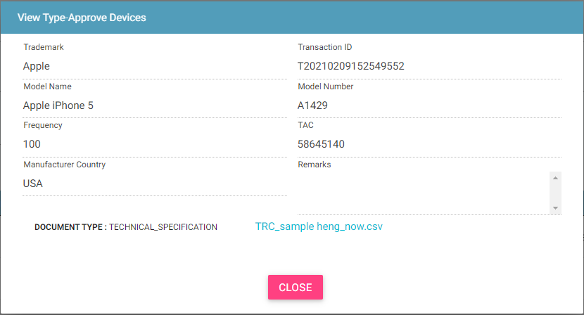
View Type Approval Request
Who all can view the Type approved TAC?
Importer
CEIR Admin
TRC
This screen is not editable. This is just to view the details filled in by the Importer or TRC user.

Slide 20
System Processing
All NEW request will be processed in FIFO order by the system
Once the processing starts, the status is changed to PROCESSING to indicate that Work is in progress
Once the processing is complete, the status is changed to either REJECTED_BY_SYSTEM or SUCCESS (PENDING_APPROVAL_FROM_CEIR_ADMIN)
Post processing an e-mail notification is sent to Importer/TRC in case of REJECTED_BY_SYSTEM and in case of SUCCESS email is sent to both Importer or TRC and CEIR Admin.

Slide 21
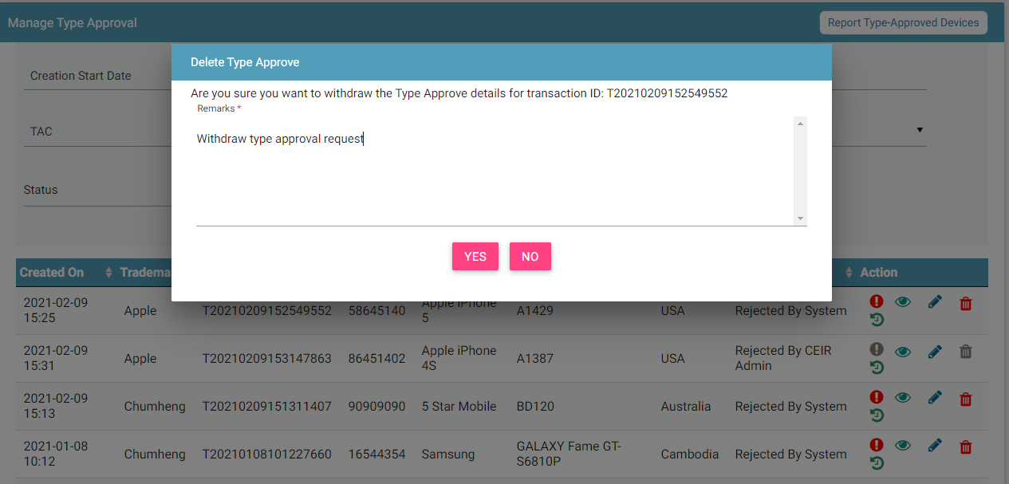
Type Approval Request Withdrawn By Importer/TRC
Importer/TRC can withdraw request in two states only
New
Rejected by System

Slide 22
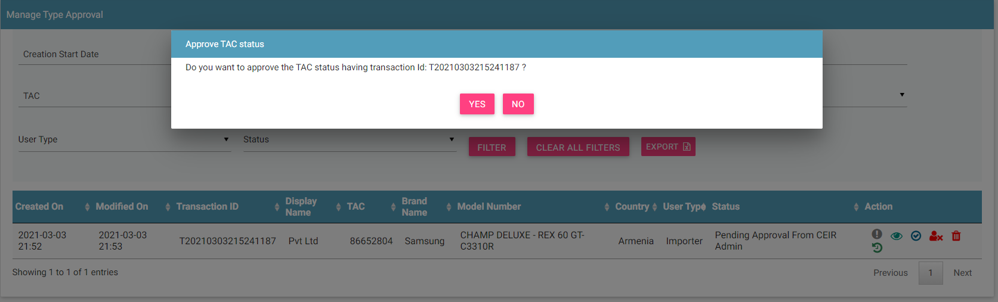
Type Approval Request - Approved by CEIR Admin
Type approval request after successful processing are sent to the CEIR Admin queue for Approval / Rejection.
On Rejection, Type approval Request are sent back to the Importer queue.

Slide 23
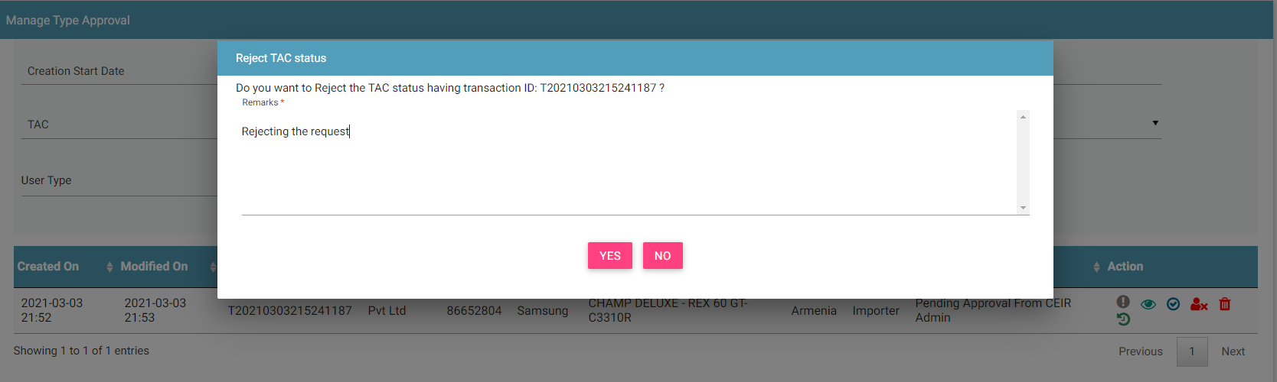
Type Approval Request - Rejected by CEIR Admin
CEIR Admin has the authority to reject any request. Remarks have to be updated for the same.

Slide 24
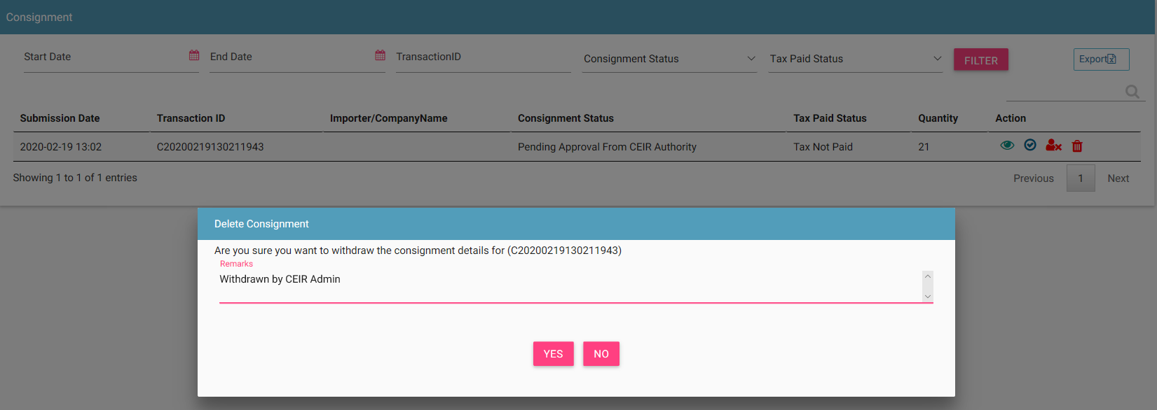
Type Approval Request - Withdrawn By CEIR Admin
CEIR Admin has the authority to withdraw any request. Remarks have to be updated for the same.

Slide 25
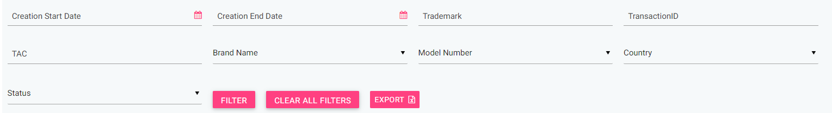
Filter Type Approval Request ( Importer/TRC)
Type Approval Request can be filtered on the basis of
Date filters Trademark Transaction ID
TAC Brand Name Model Number
Country Type Approval Status
The User ( Importer/ TRC) can also use a combination of more than one filters to filter the requests.
Users can view old Type Approved requests using the date filter.
Clear All Filters can be used to clear filters and refresh the data table.
Export button will export the data based on the filters applied.
By default, the data displayed is sorted in descending order on last modified date.
Data can be sorted based on other fields by clicking the arrow buttons on the column headers. On first click, data will be sorted in ascending order. On second click, it will be sorted in descending order.

Slide 26
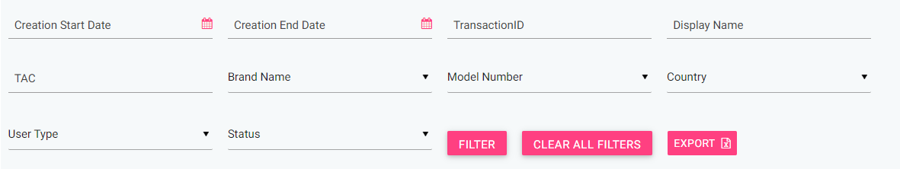
Filter Type Approval Request (CEIR Admin)
Type Approval Request can be filtered on the basis of
Date filters Transaction ID Display Name
TAC Brand Name Model Number
Country User Type Type Approval Status
The admin can also use a combination of more than one filters to filter the requests.
Admin can view old Type Approved request using the date filter.
Clear All Filters can be used to clear filters and refresh the data table.
Export button will export the data based on the filters applied.
By default, the data displayed is sorted in descending order on last modified date.
Data can be sorted based on other fields by clicking the arrow buttons on the column headers. On first click, data will be sorted in ascending order. On second click, it will be sorted in descending order.

Slide 27
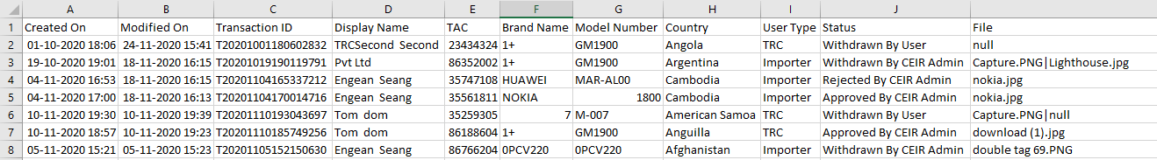
Export Type Approval Request
Type approved request can be exported in a .csv file using the export button.
User ( Importer/ CEIR Admin/TRC ) can export all type approved requests assigned to the respective user.
User ( Importer/ CEIR Admin/TRC) can export filtered type approved request.

Slide 28
Policy
Policy for grace and post grace period will be same for registering type approved request
Type Approved Request generates a TAC type Approved DB, which is then used to apply policies
More details on same would be discussed in the “Policy Management” Training session

Slide 29
What next after Approval of Type Approval?
Importer can register the consignment on the CEIR portal

Slide 30
Queries

Slide 31
Thank You

